Slide 1

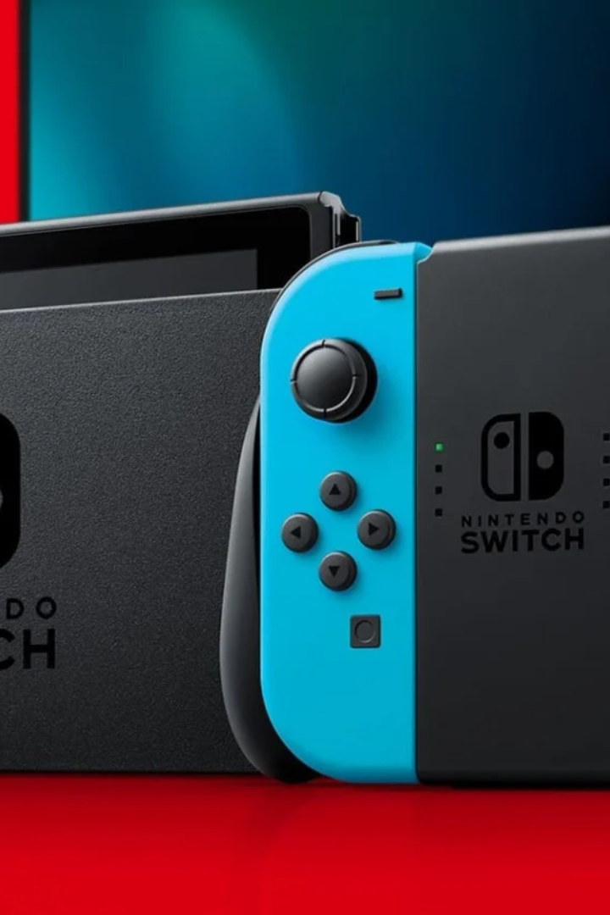
Nintendo Switch
J
By JZB JZB SZL

Slide 2

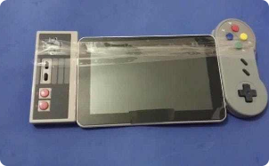
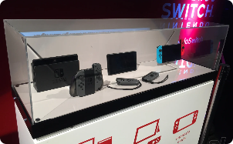
The Journey Begins
Project Initiation
Reveal Event
In early 2015
Under the leadership of Satoru Iwata, the NX project set out to redefine gaming with a hybrid console.
In 2016, Nintendo unveiled the Nintendo Switch
"Pokémon GO" became a global sensation

Slide 3
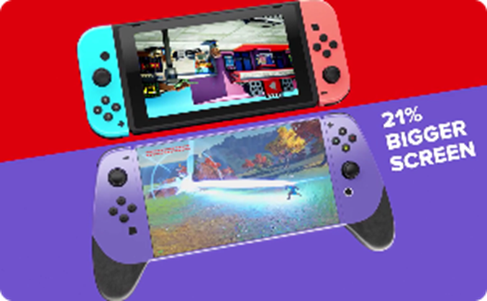
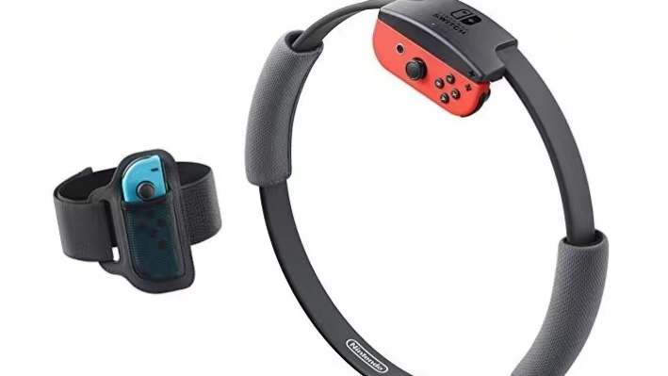
The Journey Continue
Launch Day
Process
In 2017, Nintendo released the Nintendo Switch, with critically acclaimed games
These years marked a resurgence of interest in Nintendo due to innovative hardware and beloved franchises.
In 2019 Nintendo also released hardware iterations like the handheld-only Switch Lite.
In 2021, the upgraded Switch OLED model with an improved display.

Slide 4
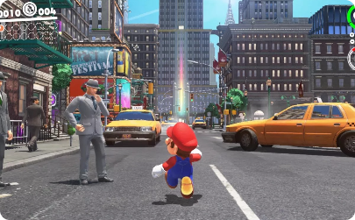
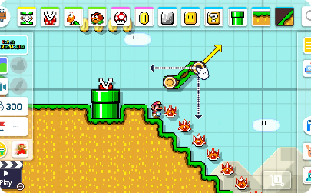
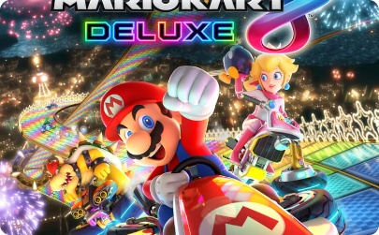
Enter the World of Mario
Released in 1985
a classic pixel adventure puzzle game
Mario can jump, run, fight with enemies and collect coins

Slide 5
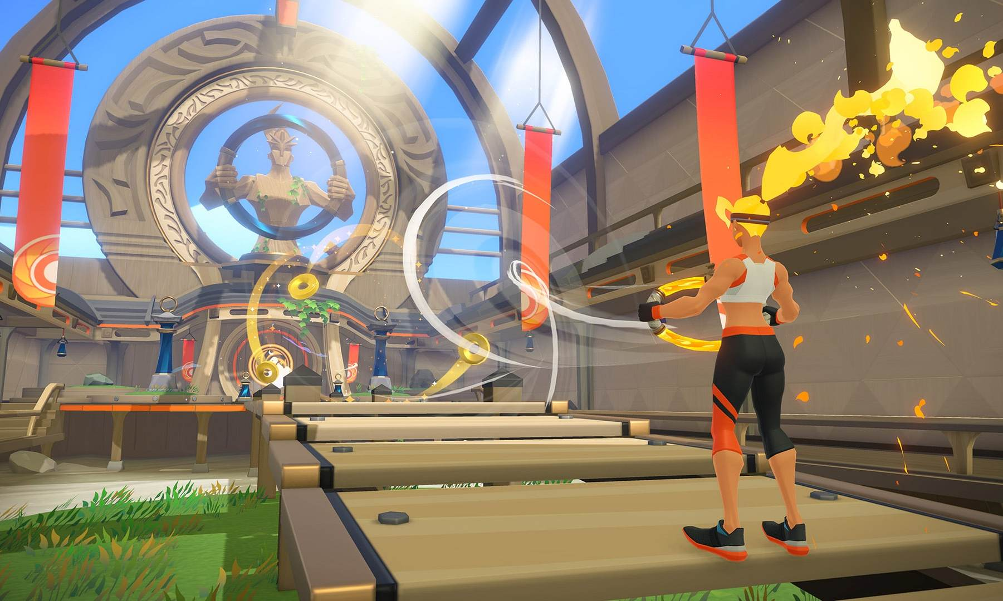
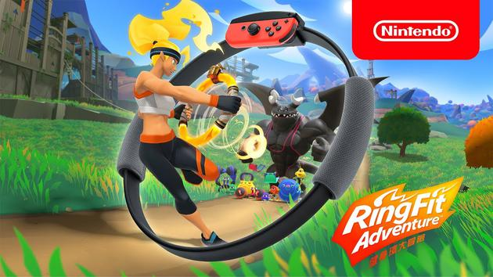
Game and Fitness Combined
Released in 2019
Ring Fit Adventure is a popular fitness game.
aerobic exercise
anaerobic exercise
breathing adjustment exercise yoga exercise
'Rare medical equipment’

Slide 6
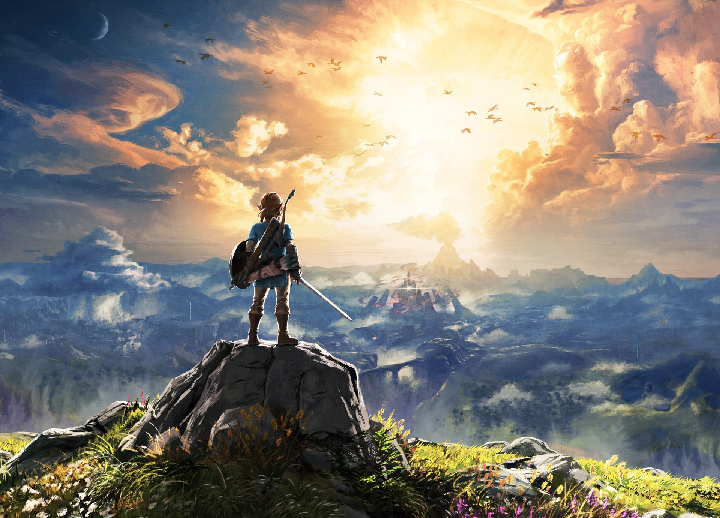
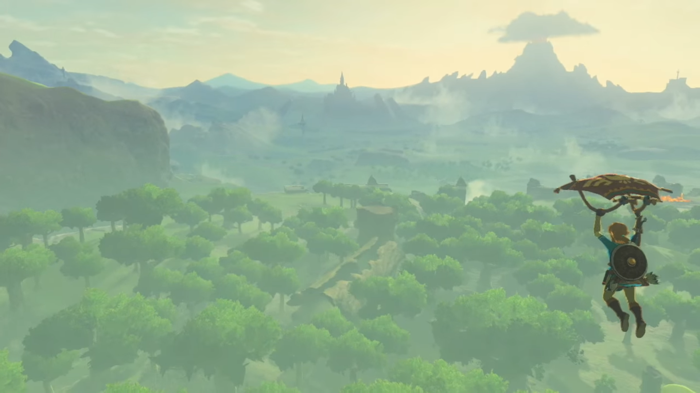
The Legend of Zelda
Open-world exploration, dungeons, and iconic music
"Ocarina of Time" and "Breath of the Wild“
the sequel to the 2017 game

Slide 7

Switch's success
Japan's unique cultural characteristics for games
Switch fits the needs of Japanese gamers

Slide 8
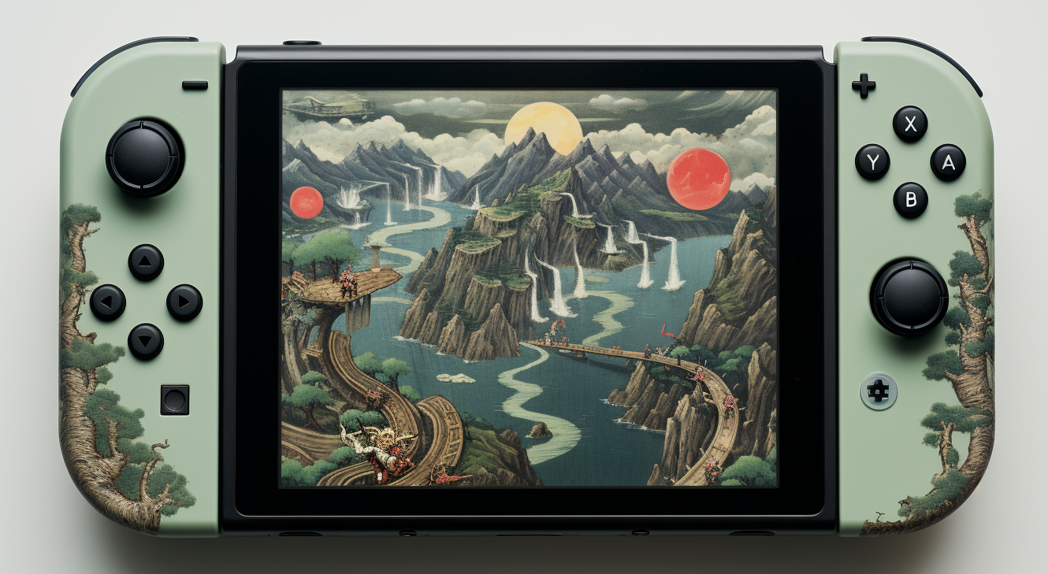
Thanks For Listening!

